Slide 1
Data Processing System
10/16/2020 Update

Slide 2
Overview
DPS UI
Administrator interface
End-user interface
2

Slide 3
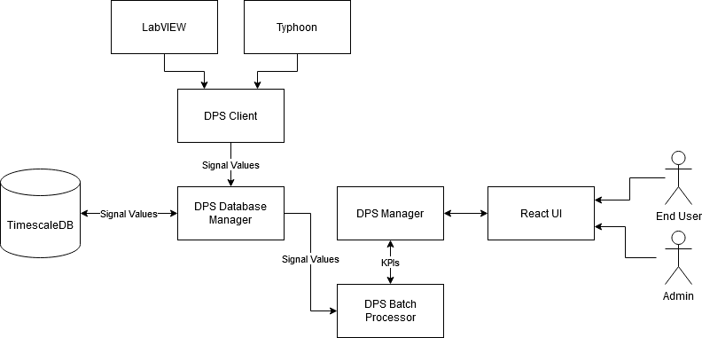
Overview
3

Slide 4
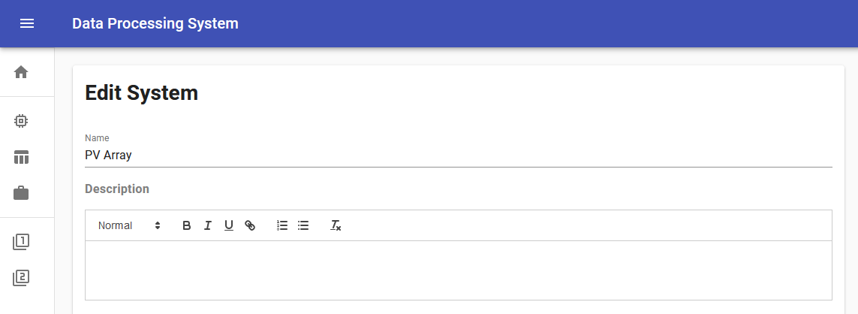
DPS UI – Administrator Interface - Systems

Slide 5
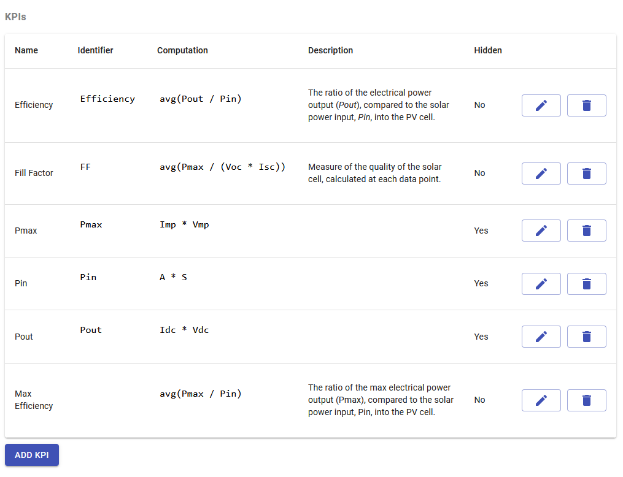
DPS UI – Administrator Interface - Systems

Slide 6
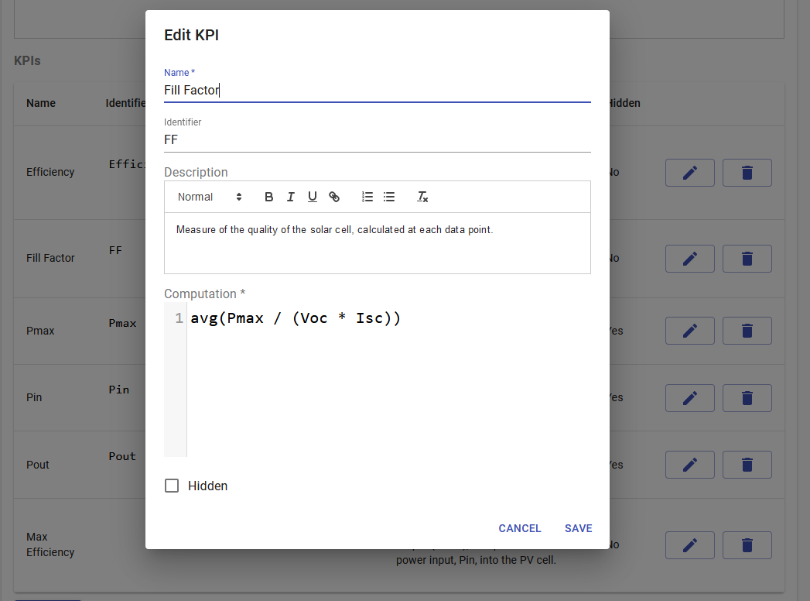
DPS UI – Administrator Interface - Systems

Slide 7
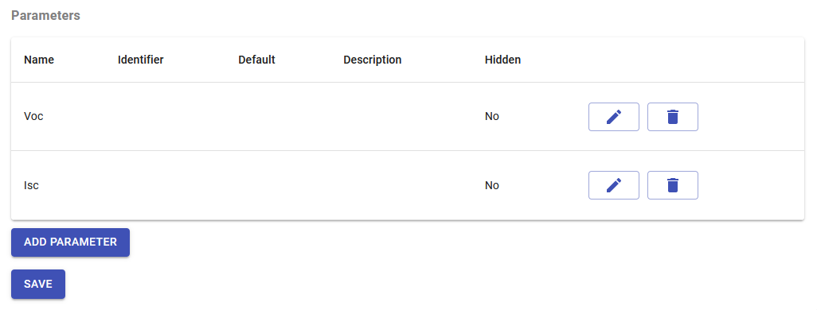
DPS UI – Administrator Interface - Systems

Slide 8
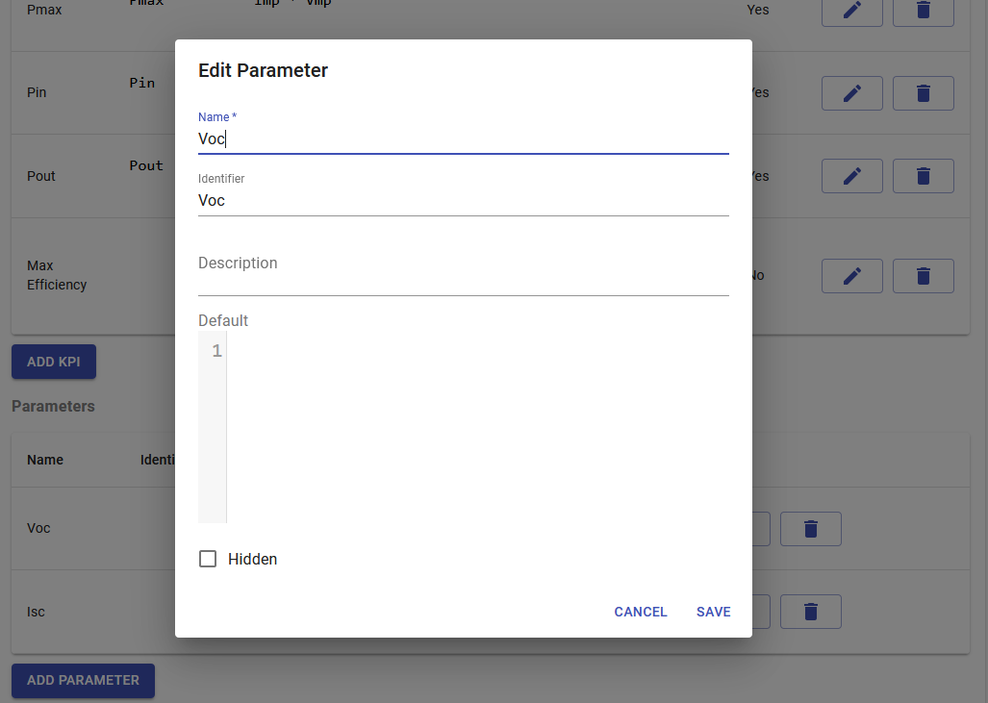
DPS UI – Administrator Interface - Systems

Slide 9
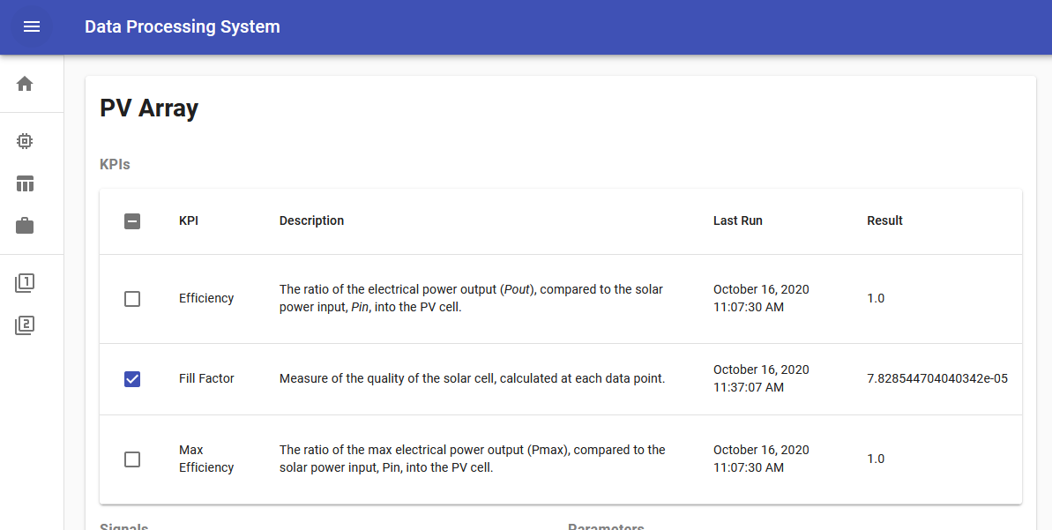
DPS UI – End-User Interface – Batch Process

Slide 10
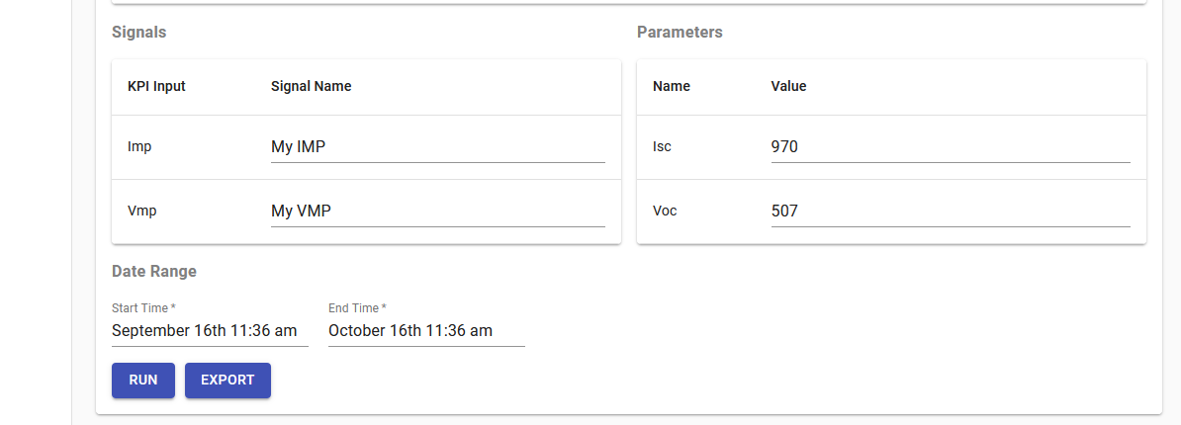
DPS UI – End-User Interface – Batch Process

Slide 11
Questions

